Slide 1
Front-End Web Development Using React (Client Side Technologies-HTML)
Front-End Web Development Using React – HTML
Eng. Reem Hassan Ahmed

Slide 2
Contents of this lecture
Introduction to Web | What is web development?
Web page creation | Clarification on how web pages are created
Client-Side technologies | Client-side languages
For more info: SLIDESGO | SLIDESGO SCHOOL | FAQS
You can visit our sister projects: FREEPIK | FLATICON | STORYSET | WEPIK | VIDFY

Slide 3
01
Cycle Of Web Browsing
Front-End Web Development Using React – HTML

Slide 4
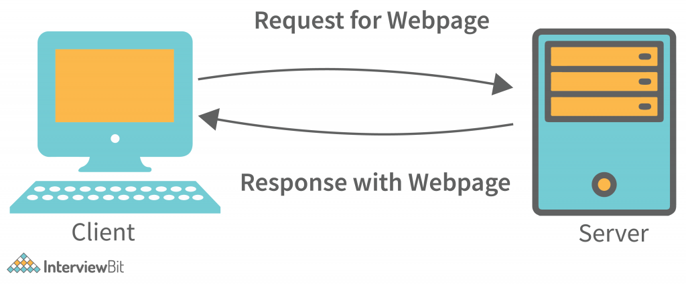
Cycle of web browsing
All website files are stored on the web server.
Every server has an IP and a unique domain name.
www.Google.com (Domain name)
Client sever architecture

Slide 5
Cycle of web browsing Cont.
Protocol: A communications protocol that provides a structure for requests between client and server in a network.
Web Server Protocol : HTTP
Email Server Protocol : SMTP
FTP Server Protocol : FTP

Slide 6
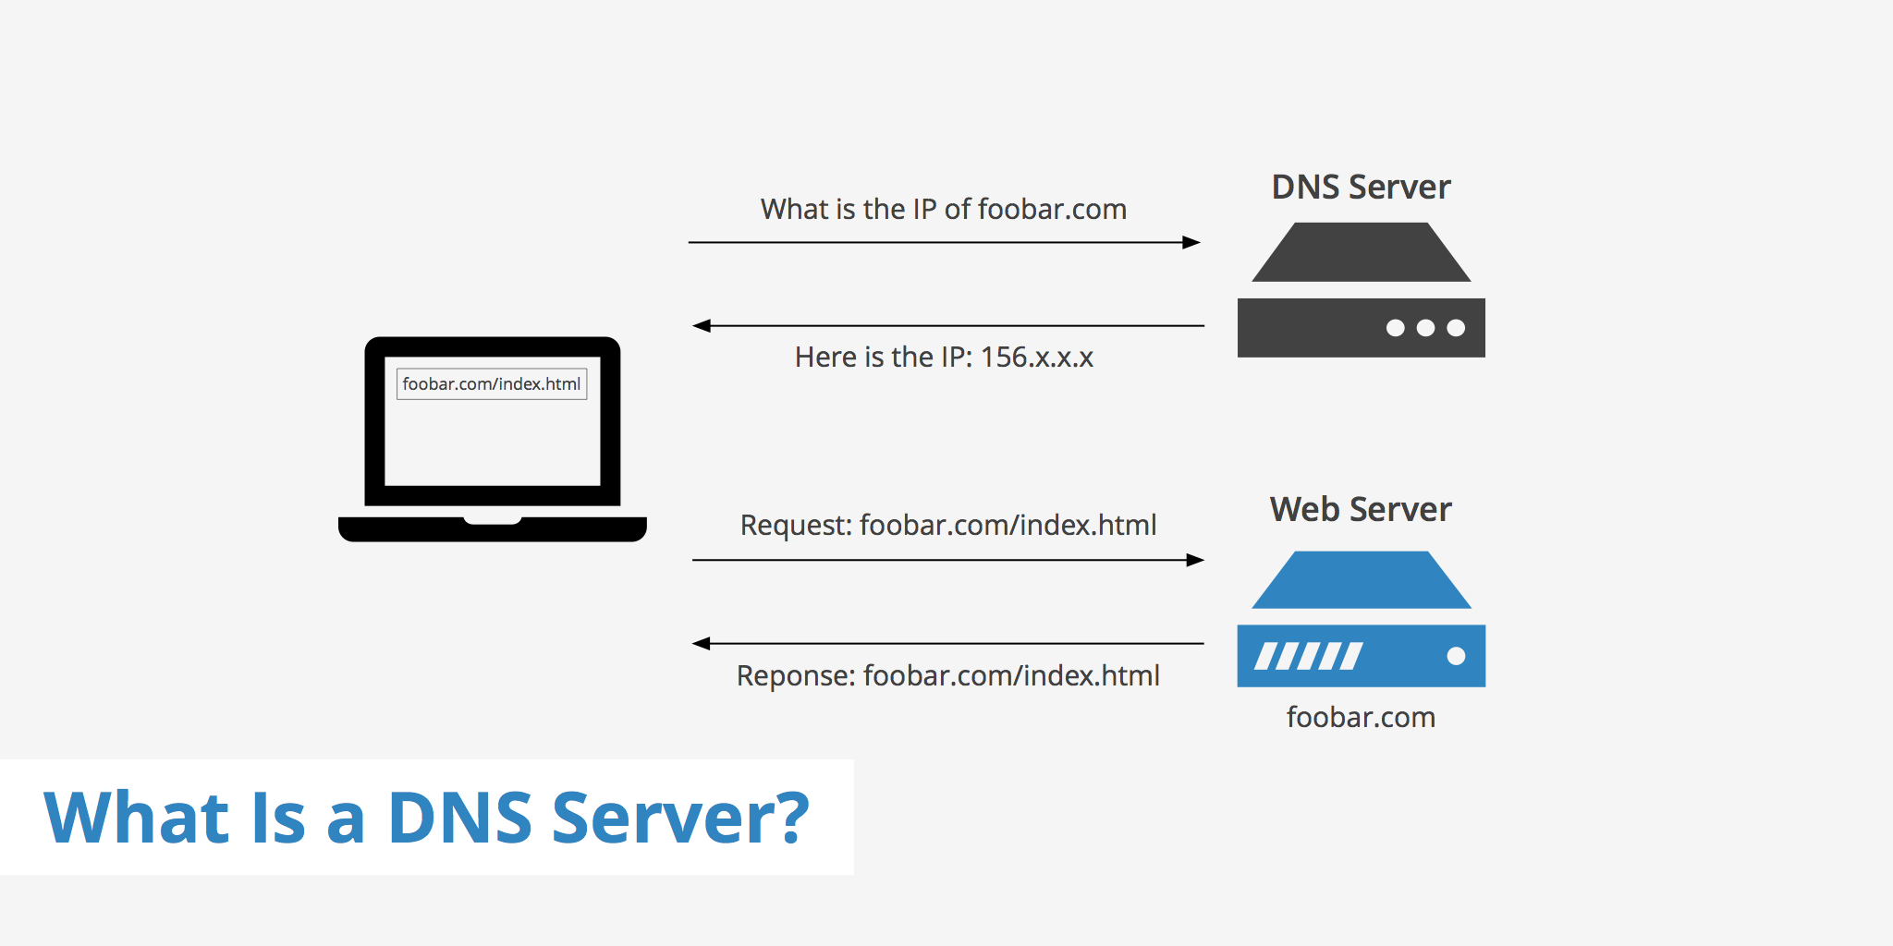
Cycle of web browsing Cont.
When we write tha domain name in th URL, the DNS translates it to IP and the prtocol a port number.

Slide 7
02
Web Pages Creation
Front-End Web Development Using React – HTML

Slide 8
Web Pages Creation
Web pages are created using some client-side and server-side languages.
Client-side languages (Front-End): are the languages that the client (browser) can understand and interpret.
Server-side languages (Back-End): are the languages that the server can understand.

Slide 9
03
Client-Side languages
Front-End Web Development Using React – HTML

Slide 10
Client-side languages
HTML (Structure)
CSS (Style)
JavaScript (Dynamic)

Slide 11
04
Intro to HTML
Front-End Web Development Using React – HTML

Slide 12
Table of contents
01
02
03
04
05
06
Client-side languages
HTML intro
What happens when we browse a website?
You can describe the topic of the section here
HTML basics
HTML iframe
You can describe the topic of the section here
You can describe the topic of the section here
HTML tables
HTML forms
You can describe the topic of the section here
You can describe the topic of the section here

Slide 13
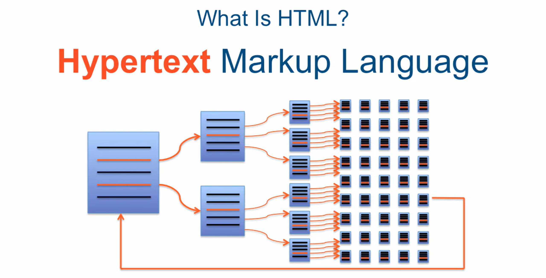
What Is HTML?
HTML stands for Hypertext Markup Language used for describing web pages (NOT a programming language).
Hypertext is text which contains links to other texts.
Markup language is a set of markup tags.

Slide 14
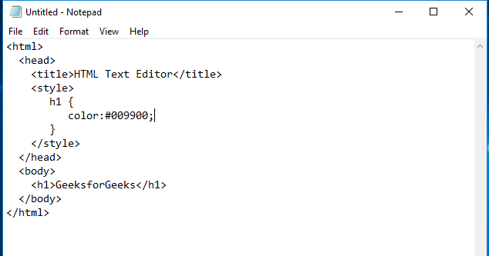
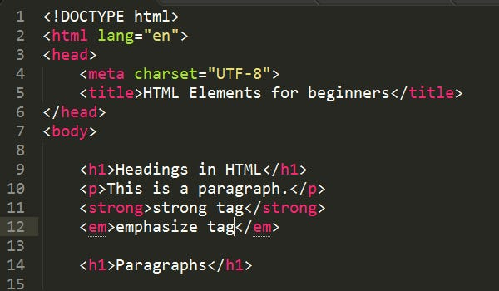
HTML Editors
Notepad.
Visual Studio Code.

Slide 15
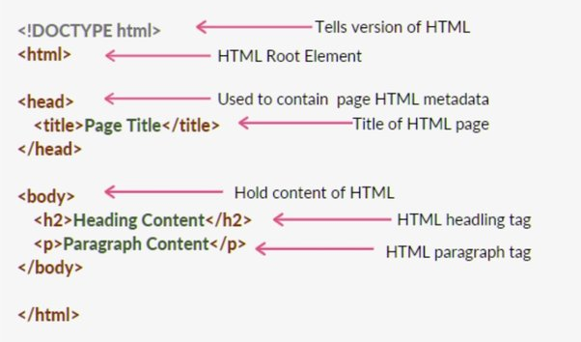
Basic HTML Structure
35%
Notes:
Meta data are information about the browser and the search engine.

Slide 16
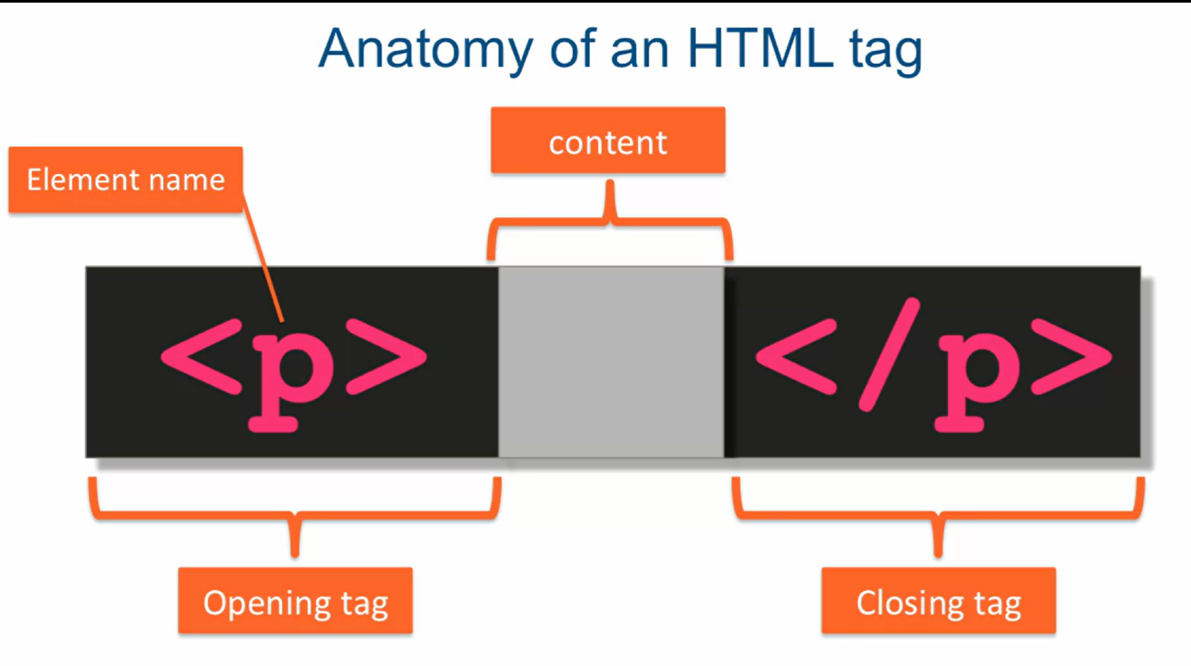
HTML Tags
<tagname>Content goes here...</tagname>
Example: <h1>My First Heading</h1>
Example: <p>My first paragraph.</p>

Slide 17
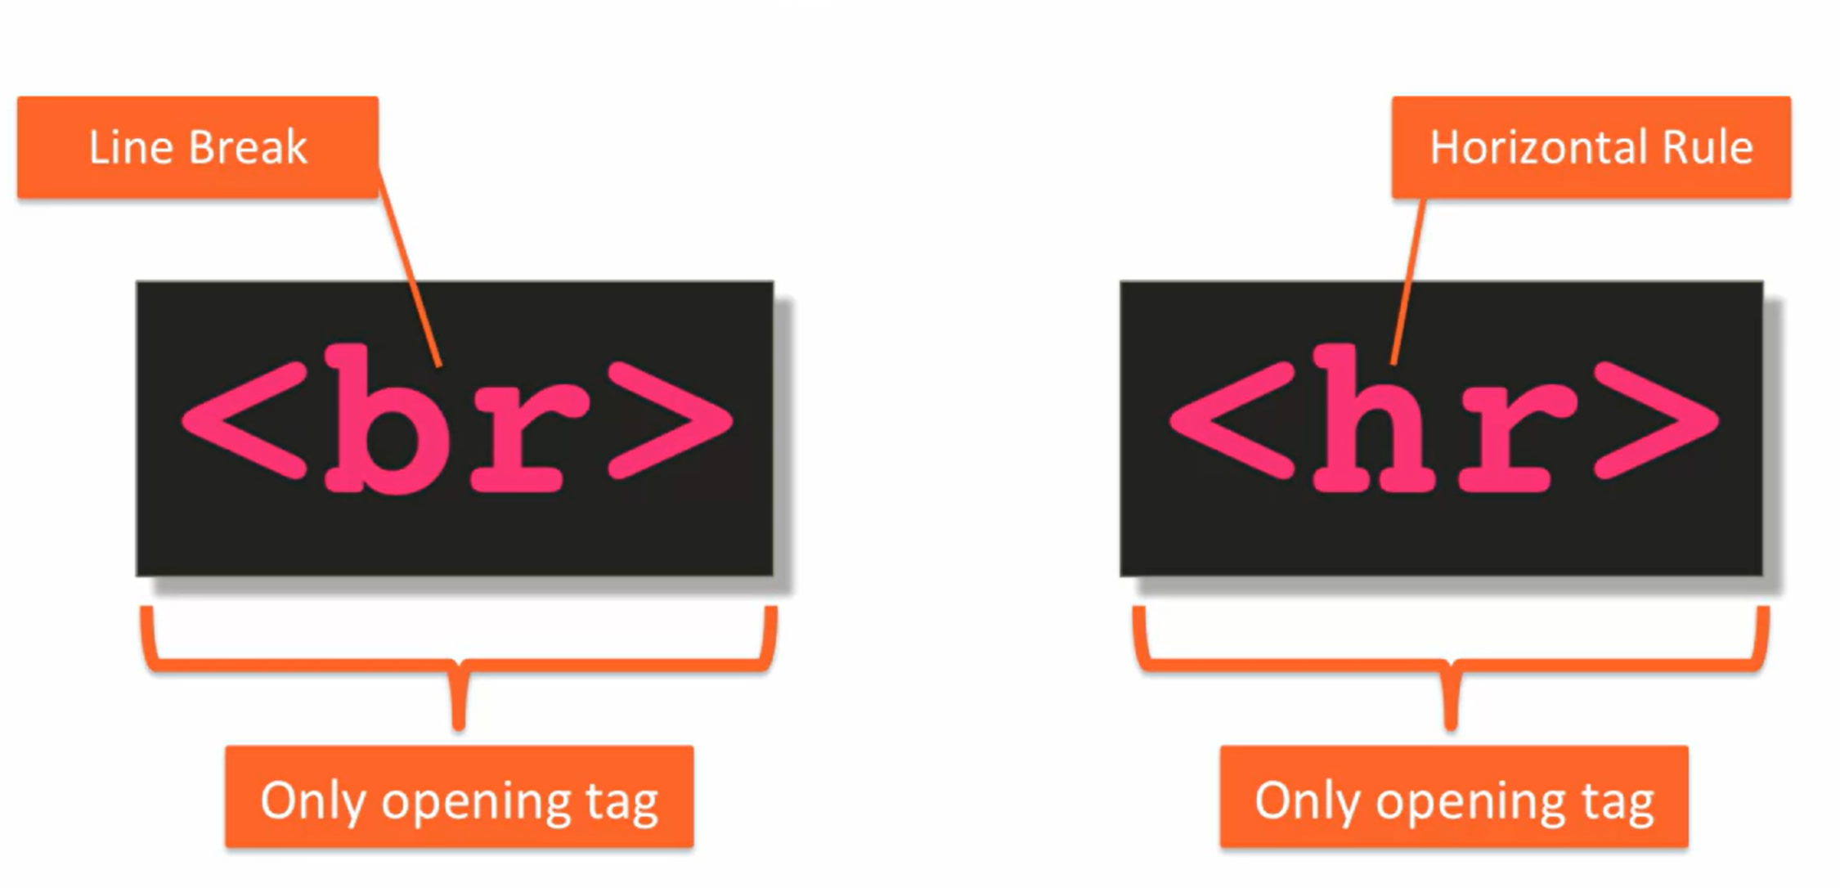
HTML Tags
Empty HTML elements: Elements that have no content and no end tags.
Example: <p>This is a <br> paragraph with a line break.</p>

Slide 18
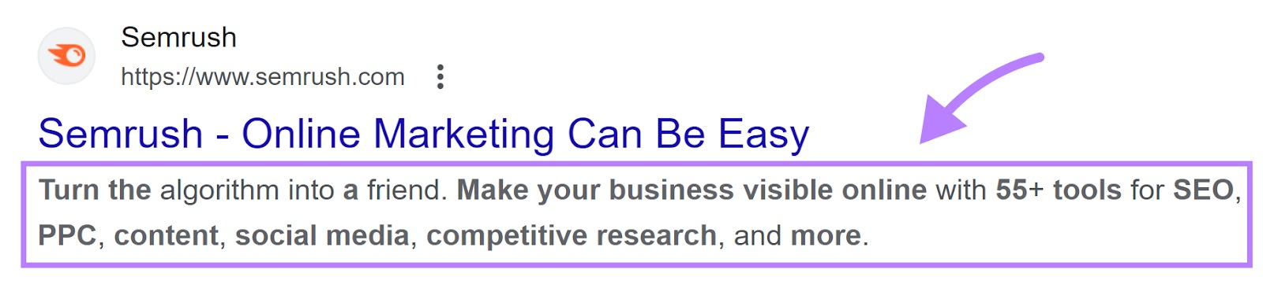
Meta tag
<meta name="Keywords" content="HTML, CSS, XHTML">
<meta name="description" content="Web development using ReactJS">
<meta name="viewport" content="width=device-width, initial-scale=1.0">
Notes:
Meta data are information about the browser and the search engine.

Slide 19
HTML most used tags
5
1
2
3
Headings
Links
4
<h1>Heading 1</h1> <h2>Heading 2</h2> <h3>Heading 3</h3> <h4>Heading 4</h4> <h5>Heading 5</h5> <h6>Heading 6</h6>
<a href="https://www.google.com"> Google </a>
Images
<img src="img_girl.jpg">
Paragraphs
Divs
<p>This is a paragraph.</p>
<div>This is a Div.</div>

Slide 20
HTML contenct odels
 | Definition | Example
Block-elements | starts on a new line, and the browsers automatically add some space (a margin) before and after the element. | <div> <p> <section> <h1> - <h6> <hr> … etc.
Inline-elements | Does not start on a new line. Only takes up as much width as necessary. | <a> <span> <br> <b> … etc.

Slide 21
HTML Entities
Reserved characters in HTML must be replaced with entities(<,>,&, White space).
To display reserved character, character entities MUST be used as &Entity_Number or &#Entity_Name.

Slide 22
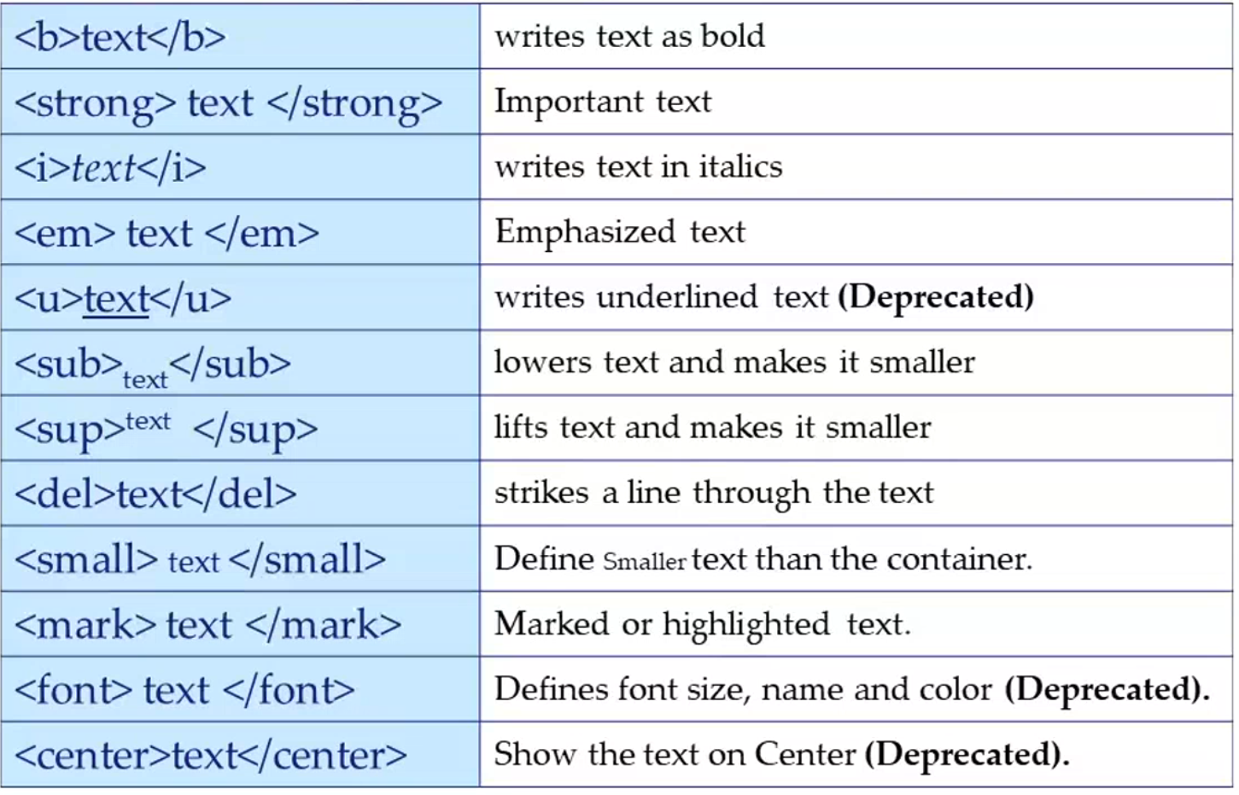
HTML Formatting

Slide 23
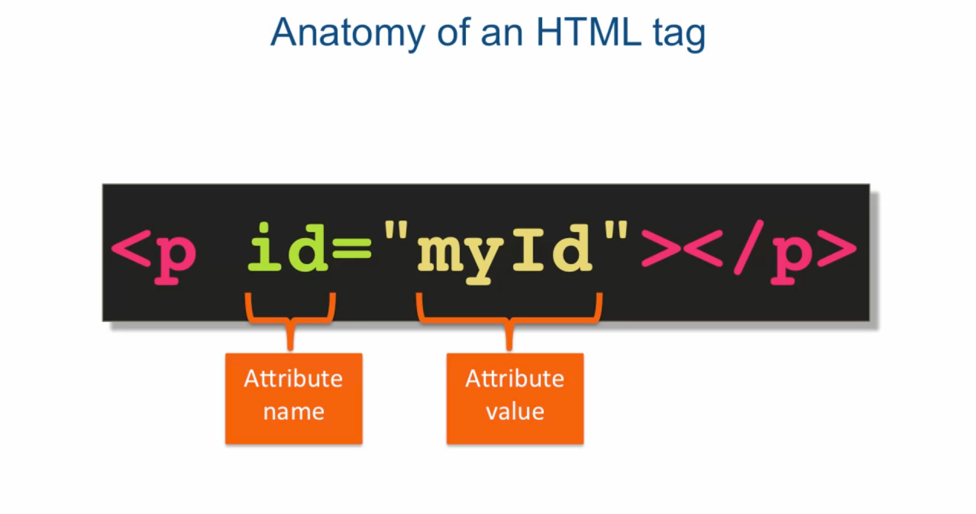
HTML Attributes
HTML attributes provide additional information about the HTML element.

Slide 24
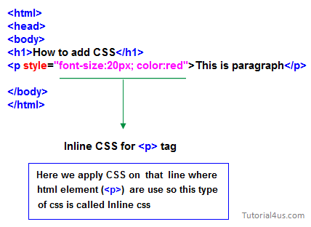
HTML Styles

Slide 25

HTML Images
Syntax:
Example:<img src="img_chania.jpg" alt="Flowers in Chania">
Note that <img> tag doesn’t have a closing tag.
src attribute - Specifies the path to the image
alt attribute - Specifies an alternate text for the image

Slide 26

HTML Links
Syntax:
Example: <a href="https://www.google.com/">Google</a>
target attribute: attribute specifies where to open the linked document.
_blank value: Opens the document in a new window or tab.
Example: <a href="https://www.google.com/" target="_blank">Google</a>

Slide 27
Thanks!
Front-End Web Development Using React – HTML
Does anyone have any question?
ReemHassan160299@gmail.com
+201092427577
Please keep this slide for attribution

